Slide 1

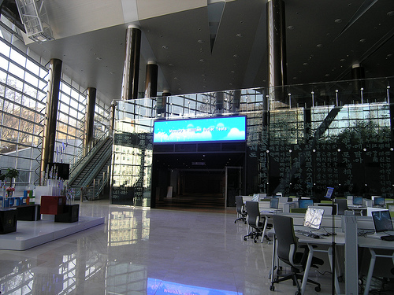

Media and Information literacy (MIL)
Jagdish Arora
Director, INFLIBNET Centre
director@inflibnet.ac.in

Slide 2

overview
Overview (MIL)
MIL activities @INFLIBNET
E-PG Pathshala
Methodology
Module/ Volume of Work

Slide 3
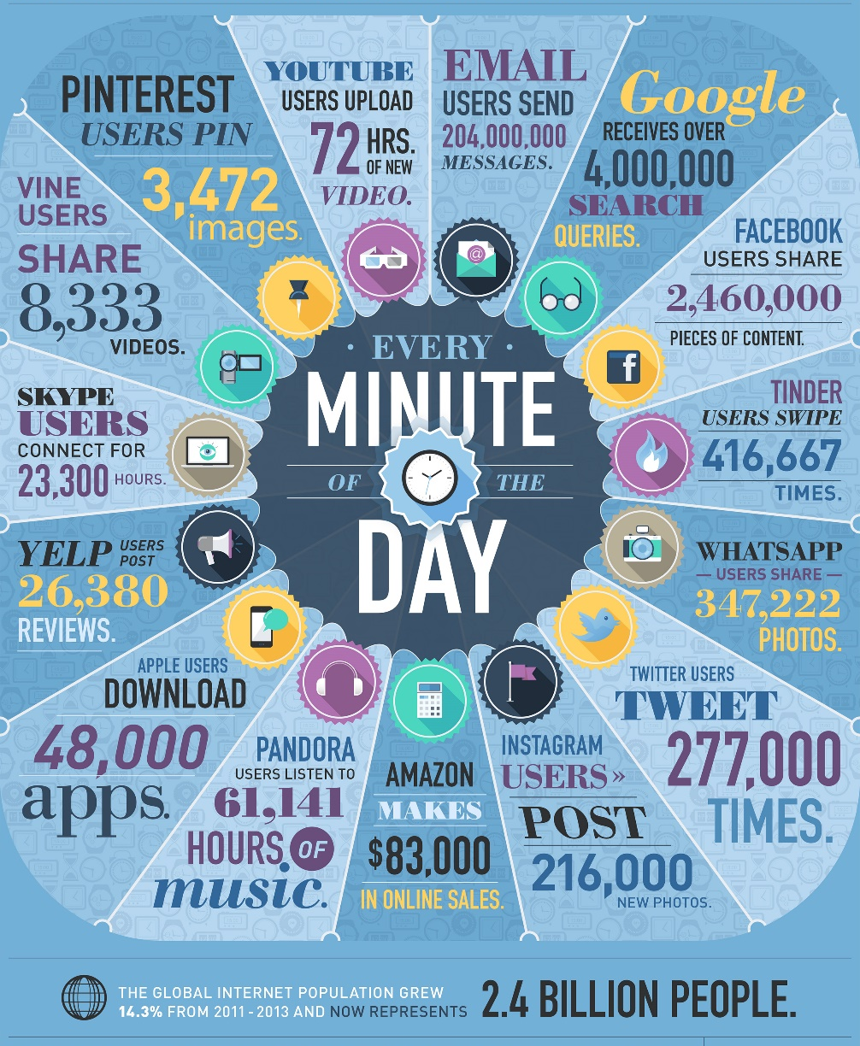
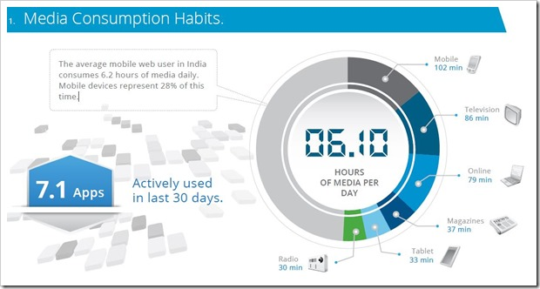
Information flow and Media Consumption Habits
Notes:
Information flow and media consumption habits

Slide 4
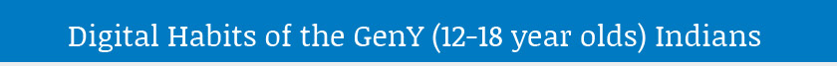
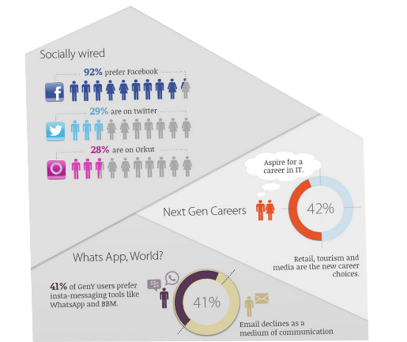
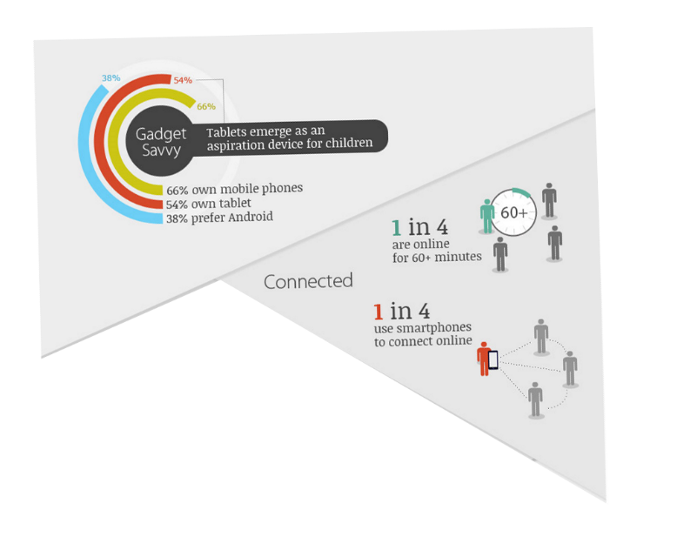

Slide 5
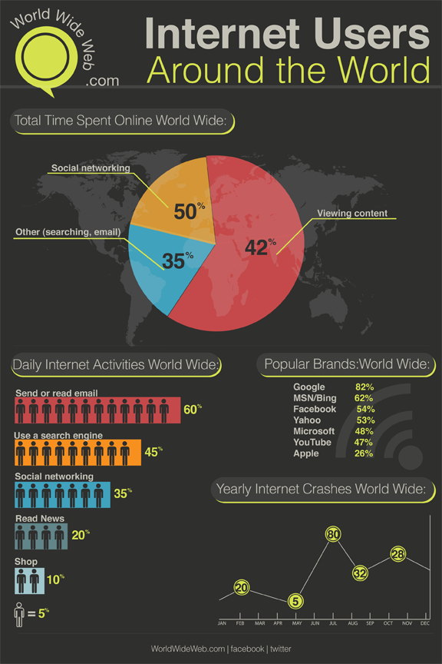
Internet users around the World

Slide 6
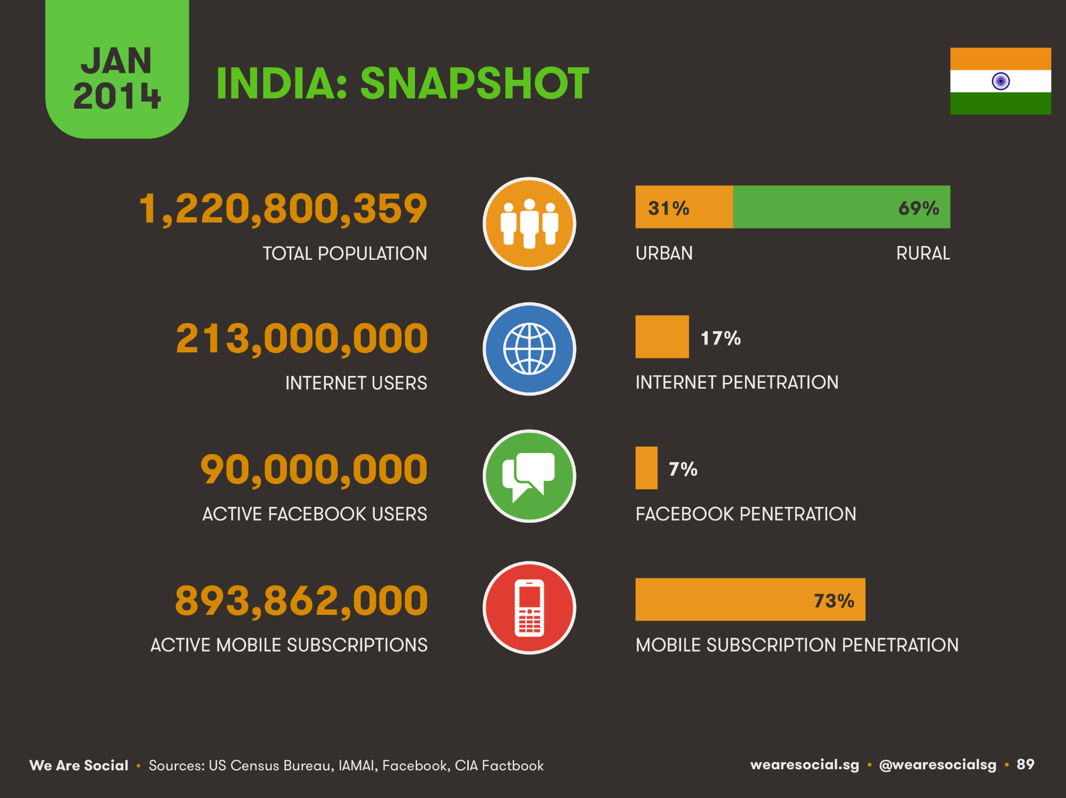
Internet users in India
Notes:
What is Internet Penetration
1.
The relationship between the number of Internet users in each country and its demographic data. Learn more in: The Digital Divide, Framing and Mapping the Phenomenon
2.
Indicates the percentage of internet users in any country. Learn more in: The Role of National Culture on E-Recruitment in India and Mexico

Slide 7
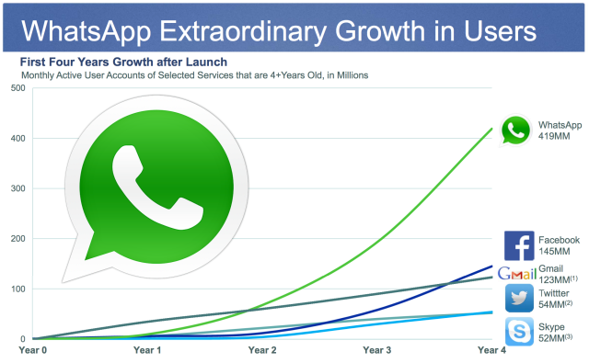
Social Media users in the World

Slide 8
Facebook buys WhatsApp
Facebook buy WhatsApp for $19 billion, company’s largest acquisition.
All 55 employees of WhatsApp including its founders will be joining Facebook.
Mark Zuckerberg
Facebook CEO, Feb. 2014

Slide 9
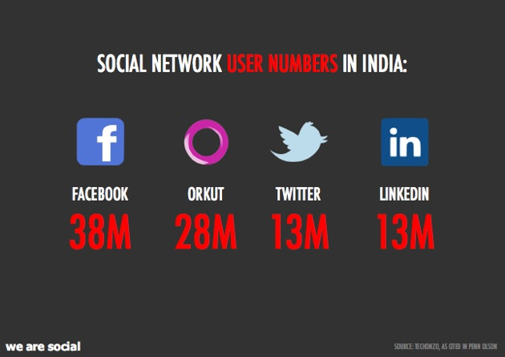
Social Media users in India

Slide 10
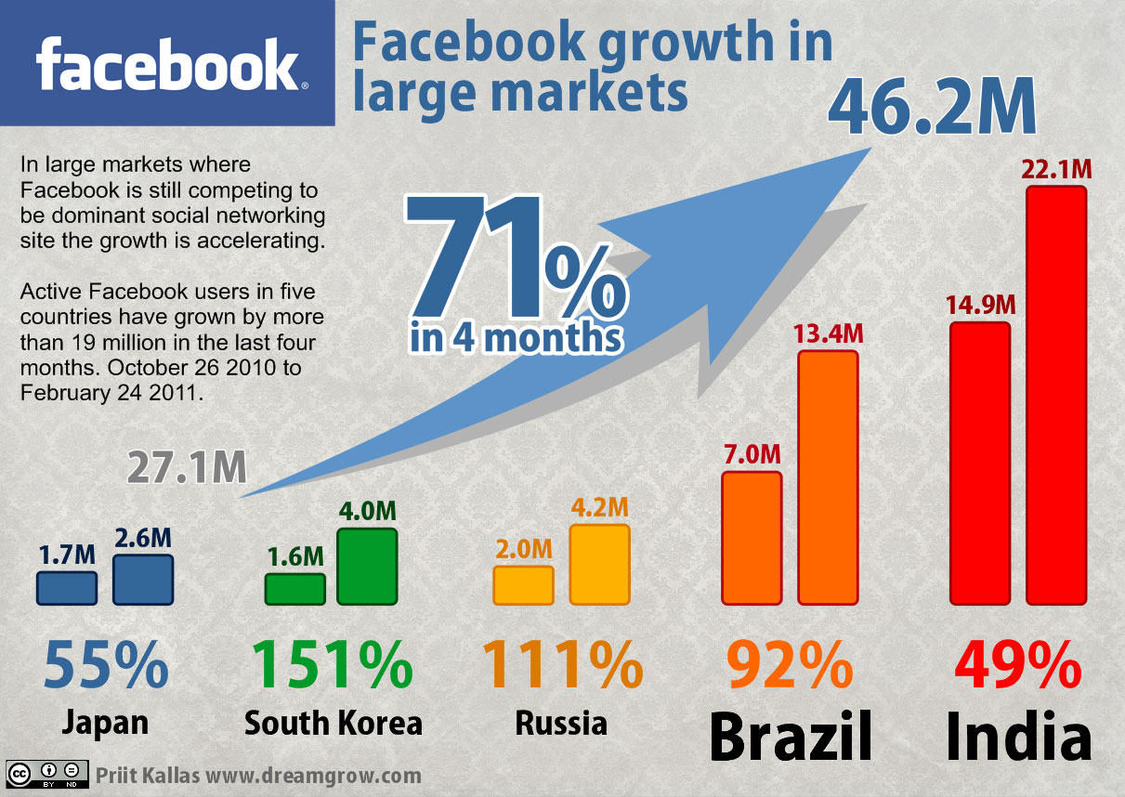
Info graphic for media data flow and media usage

Slide 11
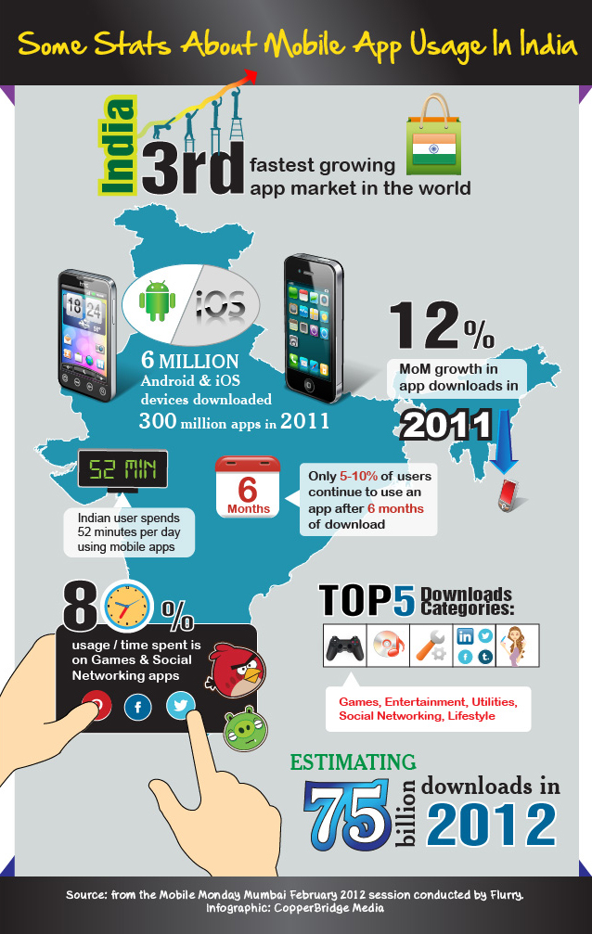

Slide 12

Information Literacy
“Fundamentally, information literacy is the ability to recognise when information is needed, then locate and evaluate the appropriate information and use it effectively and responsibly”
-American Library Association, 1989

Slide 13
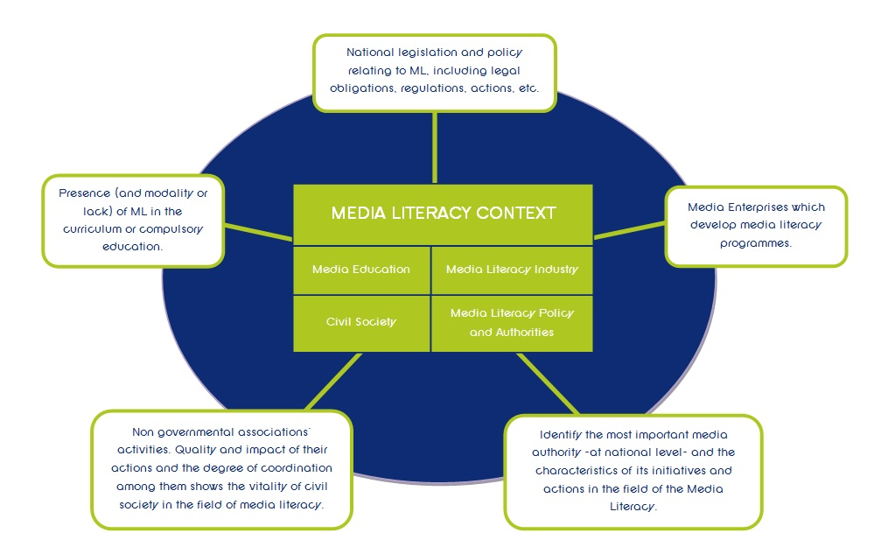
Media Literacy
The ability to ACCESS, ANALYZE, EVALUATE, and COMMUNICATE information in a variety of forms-is interdisciplinary by nature. Media literacy represents a necessary, inevitable, and realistic response to the complex, ever-changing electronic environment and communication cornucopia that surround us.
To become a successful student, responsible citizen, productive worker, or competent and conscientious consumer, individuals need to develop expertise with the increasingly sophisticated information and entertainment media that address us on a multi-sensory level, affecting the way we think, feel, and behave.
Notes:
http://namle.net/publications/media-literacy-definitions/
National Association for Media literacy
What is Media Literacy?
The ability to ACCESS, ANALYZE, EVALUATE, and COMMUNICATE information in a variety of forms-is interdisciplinary by nature. Media literacy represents a necessary, inevitable, and realistic response to the complex, ever-changing electronic environment and communication cornucopia that surround us.
To become a successful student, responsible citizen, productive worker, or competent and conscientious consumer, individuals need to develop expertise with the increasingly sophisticated information and entertainment media that address us on a multi-sensory level, affecting the way we think, feel, and behave.
Today’s information and entertainment technologies communicate to us through a powerful combination of words, images, and sounds. As such, we need to develop a wider set of literacy skills helping us to both comprehend the messages we receive and effectively utilize these tools to design and distribute our own messages. Being literate in a media age requires critical thinking skills that empower us as we make decisions, whether in the classroom, the living room, the workplace, the boardroom, or the voting booth.

Slide 14
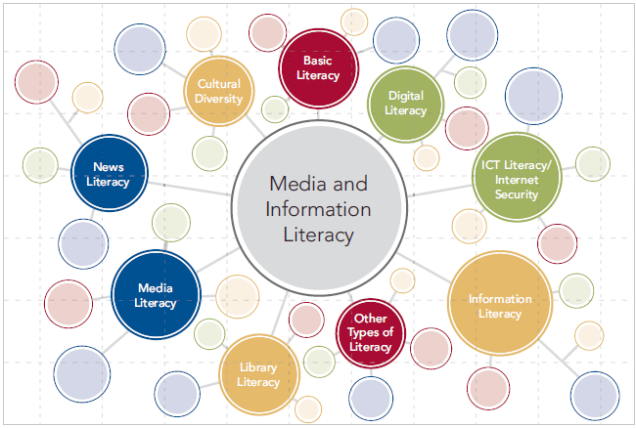
Media and information literacy
MIL is defined as set of competencies that empowers citizens to access, retrieve, understand, evaluate and use, to create as well as share information and media content in all formats, using various tools, in a critical, ethical and effective way, in order to participate and engage in personal, professional and societal activities -UNESCO
Notes:
http://www.uis.unesco.org/Communication/Documents/media-and-information-literacy-assessment-framework.pdf
Benefit of MIL:Media and information literacy should be considered as a whole and include a combination of competencies (knowledge, skills and attitudes).
The MIL curriculum enable the students to understand the concept and depth overview of media and information literacy with the objective of providing them with essential tools so that they can engage with media and information channels as autonomous and rational young citizens.
Citizens should have knowledge about location and consumption of information as well as about the production of information.
Women, men and marginalized groups, such as people living with disability, indigenous peoples or ethnic minorities, should have equal access to information and knowledge.
MIL should be seen as an essential tool to facilitate intercultural dialogue, mutual understanding and a cultural understanding of people.

Slide 15
Key Concepts for Media Literacy
Media are constructions
Audiences negotiate meaning
Media have commercial implications
Media have social and political implications
Each medium has a unique aesthetic form
Notes:
Key Concepts for Media Literacy
Media educators base their teaching on key concepts for media literacy, which provide an effective foundation for examining mass media and popular culture. These key concepts act as filters that any media text has to go through in order for us to critically respond. To teach the key concepts to students see the resources in our Media Minutes program.
1. Media are constructions
Media products are created by individuals who make conscious and unconscious choices about what to include, what to leave out and how to present what is included. These decisions are based on the creators’ own point of view, which will have been shaped by their opinions, assumptions and biases – as well as media they have been exposed to. As a result of this, media products are never entirely accurate reflections of the real world – even the most objective documentary filmmaker has to decide what footage to use and what to cut, as well as where to put the camera – but we instinctively view many media products as direct representations of what is real.
Ask:
Who created this media product?
What is its purpose?
What assumptions or beliefs do its creators have that are reflected in the content?
2. Audiences negotiate meaning
The meaning of any media product is not created solely by its producers but is, instead, a collaboration between them and the audience – which means that different audiences can take away different meanings from the same product. Media literacy encourages us to understand how individual factors, such as age, gender, race and social status affect our interpretations of media.
Ask:
How might different people see this media product differently?
How does this make you feel, based on how similar or different you are from the people portrayed in the media product?
3. Media have commercial implications
Most media production is a business and must, therefore, make a profit. In addition, media industries belong to a powerful network of corporations that exert influence on content and distribution. Questions of ownership and control are central – a relatively small number of individuals control what we watch, read and hear in the media. Even in cases where media content is not made for profit – such as YouTube videos and Facebook posts – the ways in which content is distributed are nearly always run with profit in mind.
Ask:
What is the commercial purpose of this media product (in other words, how will it help someone make money)?
How does this influence the content and how it’s communicated?
If no commercial purpose can be found, what other purposes might the media product have (for instance, to get attention for its creator or to convince audiences of a particular point of view).
How do those purposes influence the content and how it’s communicated?
4. Media have social and political implications
Media convey ideological messages about values, power and authority. In media literacy, what or who is absent may be more important than what or who is included. These messages may be the result of conscious decisions, but more often they are the result of unconscious biases and unquestioned assumptions – and they can have a significant influence on what we think and believe.
As a result, media have great influence on politics and on forming social change. TV news coverage and advertising can greatly influence the election of a national leader on the basis of image; representations of world issues, both in journalism and fiction, can affect how much attention they receive; and society’s views towards different groups can be directly influenced by how – and how often – they appear in media.
Ask:
Who and what is shown in a positive light? In a negative light?
Why might these people and things be shown this way?
Who and what is not shown at all?
What conclusions might audiences draw based on these facts?
5. Each medium has a unique aesthetic form
The content of media depends in part on the nature of the medium. This includes the technical, commercial and storytelling demands of each medium: for instance, the interactive nature of video games leads to different forms of storytelling – and different demands on media creators – that are found in film and TV.
Ask:
What techniques does the media product use to get your attention and to communicate its message?
In what ways are the images in the media product manipulated through various techniques (for example: lighting, makeup, camera angle, photo manipulation)?
What are the expectations of the genre (for example: print advertising, TV drama, music video) towards its subject?

Slide 16
MIL-related Activities at INFLIBNET Centre
Programme | Project
User Awareness Programme | UGC-INFONET and NLIST
Electronic Resources to Universities | UGC-INFONET
Electronic Resources to Colleges | NLIST
Open Access Movement | Shodhganga, OJAS, Shodhgangothri & IR@INFLIBNET
International and National level Conference | CALIBER and PLANNER
E-Content Development | E-PG Pathshala

Slide 17
MIL-related Activities at INFLIBNET Centre
PDF Tutorials for Every e-Resources
Spoken Tutorials for
  UGC-Infornet Digital Library Consortium
  N-LIST

Slide 18
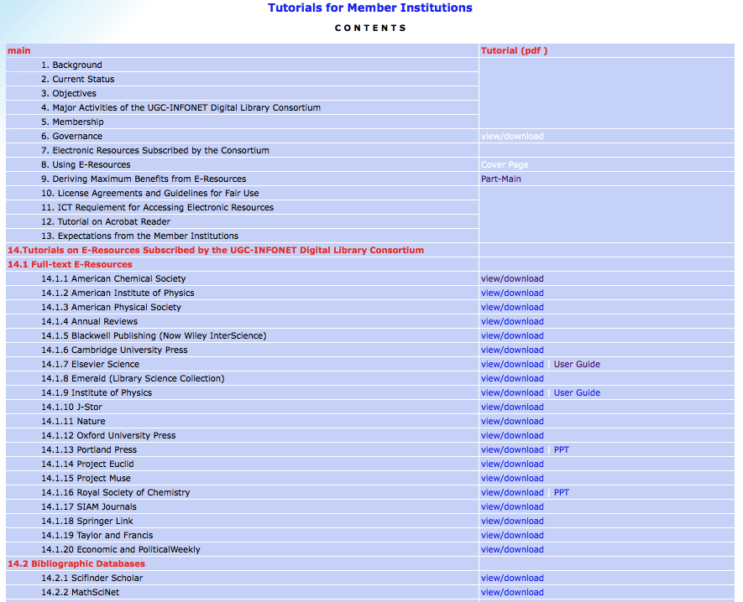

Slide 19
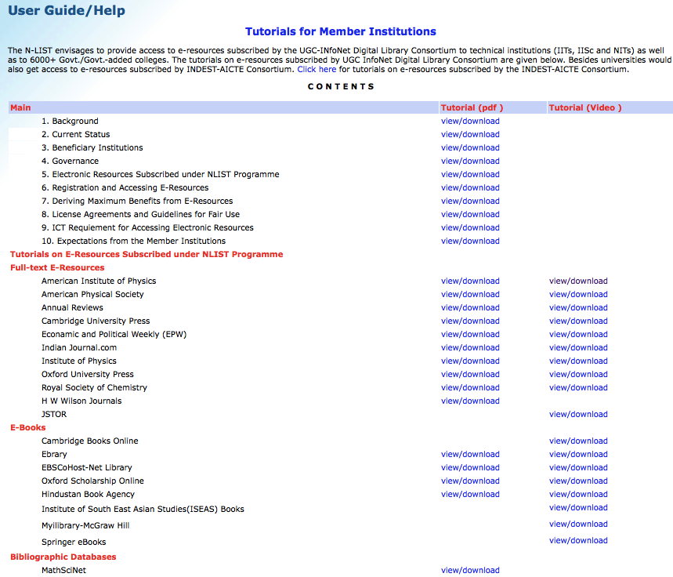

Slide 20

e-PG Pathshala
MHRD, under its NME-ICT, has allocated funds to the UGC for development of e-content in 71 subjects at postgraduate level.
E- PG Pathshala
http://epgp.inflibnet.ac.in
Social Sciences, Arts, Humanities, Natural & Mathematical Sciences, linguistics and languages

Slide 21

01
e-PG Pathshala
MHRD, under NME-ICT, has allocated funds to the UGC for development of e-content in 71 subjects at postgraduate level.
The UGC has constituted a Standing Committee, e-PG Pathshala, to monitor and coordinate the activity of content creation under the Chairmanship of Prof. M. Anandakrishnan and also included members of Standing Committee, NME-ICT.
Aim of the Project is to Develop e-Content, and Not Merely Content for Postgraduate Students in 71 Subjects

Slide 22
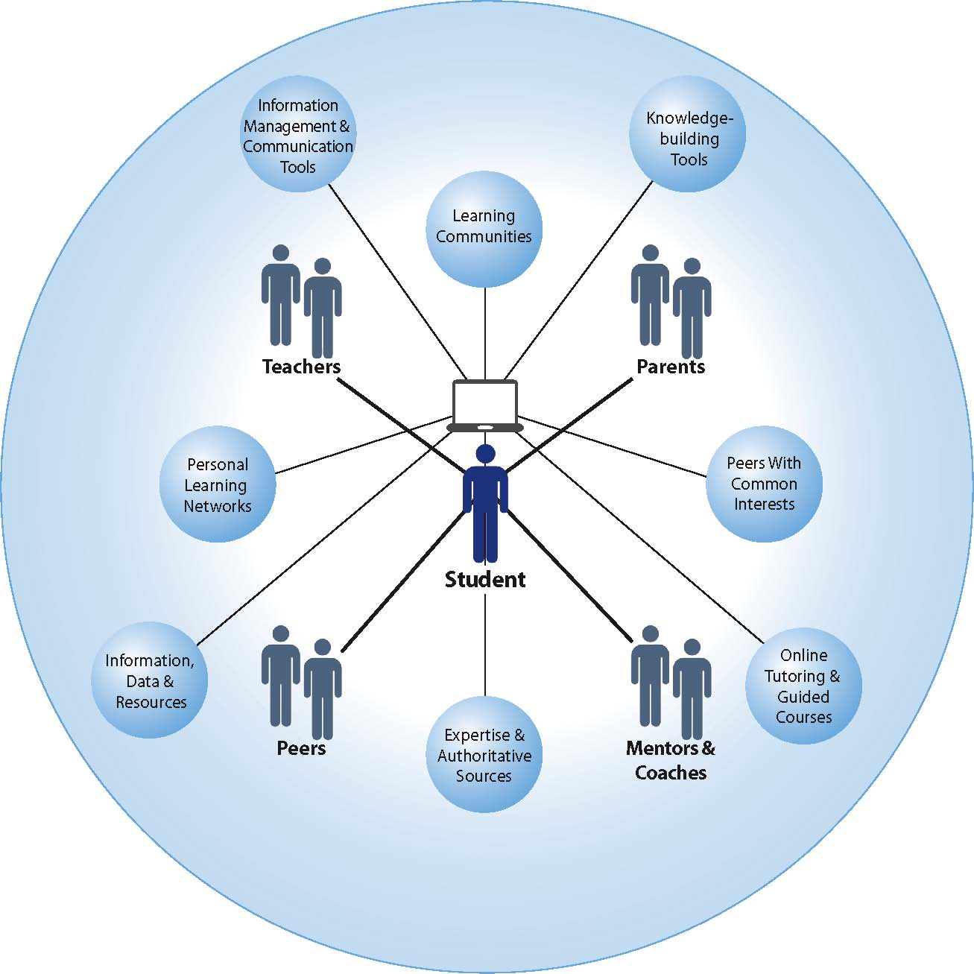

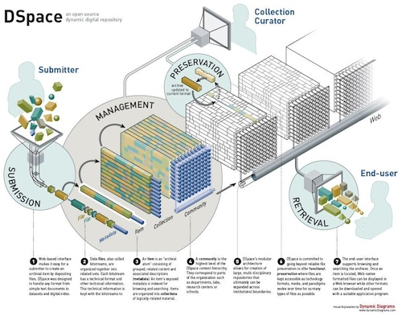

04
Central University
University of Hyderabad
University of Delhi
SGTB Khalsa College
Jawaharlal Nehru University
University of Allahabad
Banaras Hindu University
Institute of Medical Science
State University
Anna University
University of Mumbai
University of Mysore
BCUD, SNDT Women's University
University of Pune
M D University, Rohtak
Gujarat University
National Law University
Panjab University
University of Jammu
The M.S. Univ. of Baroda
University of Calcutta
Anna University
Jadavpur University
Sri Venkateshwara University
Centrally funded
PDPM-IIIT-DM, Jabalpur
INFLIBNET Centre
Deemed University
Rashtriya Sanskrit Sansthan Deemed University,
Dayalbagh Educational Institute, Dayalbagh, AGRA-,
.

Slide 23
Volume of work
Volume of a subject
1 Subject = 16 Paper*
1 Paper = 30-35 Module (40 Hr lecture)
Total module = 16 X 35 = 560
volume of a module
1 Module = 1 topic comprises of
e-text = textual material
Self- learning = audio / video component
Self assessment = Questions
Learn More = further reference material
* 4 core paper of each semester )2Yr course)

Slide 24
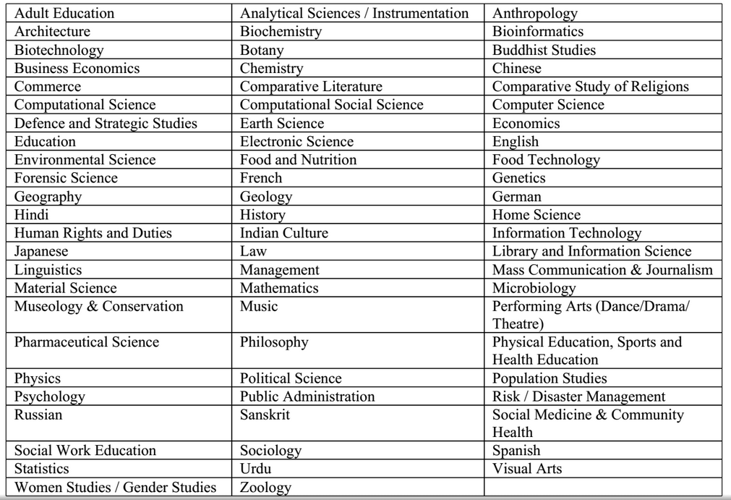
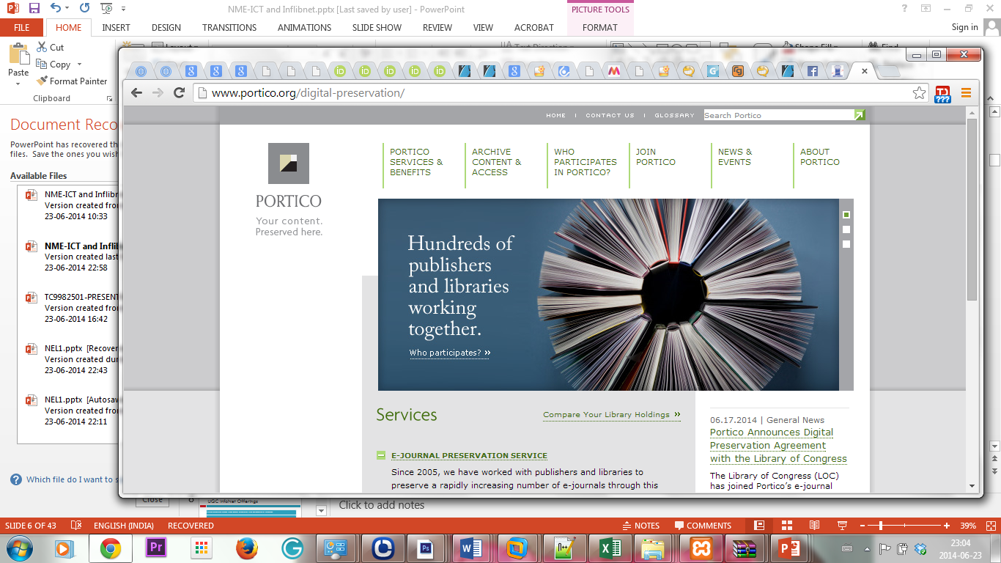
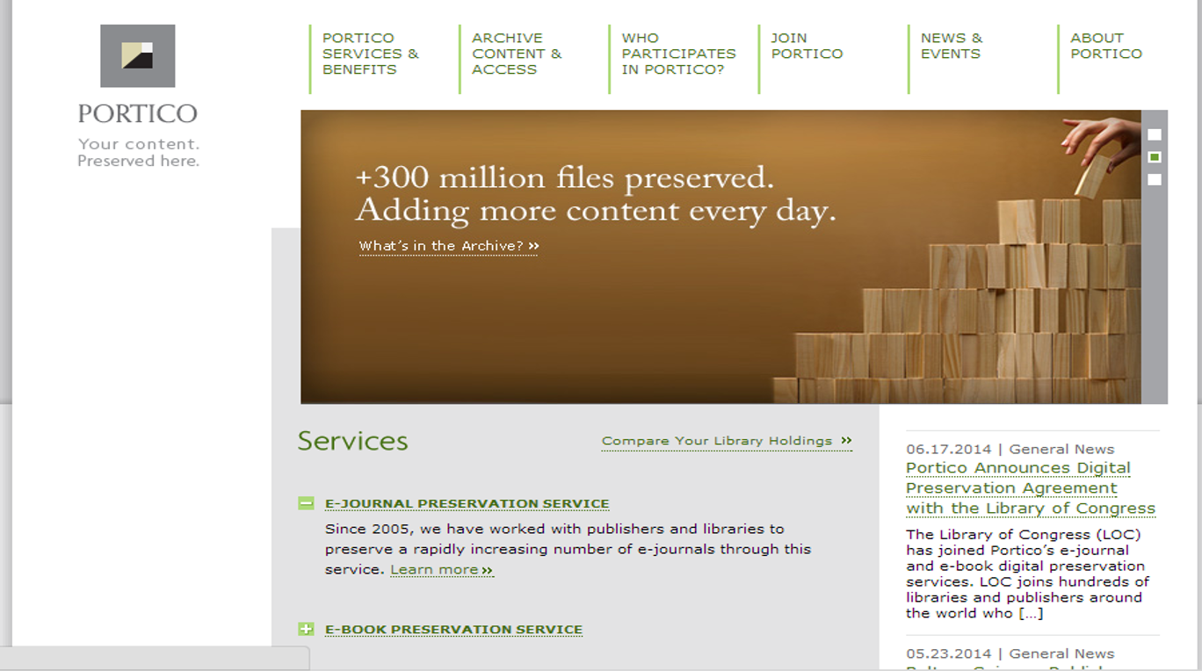
Subjects under e-PG Pathshala
Users

Slide 25

01
Methodology
Standing Committee identifying one subject expert, called Principal Investigator (PI) for each subject.
PI is completely responsible for e-content development of assigned subject.
INFLIBNET prepared platform for hosting all e-contents, interfaces for different requirement (e-Pathshala Management System, online PI application) along with disbursement of funds to PIs institute
Standing Committee constituted Monitoring Cell at UGC to monitor the work progress made by each PIs

Slide 26






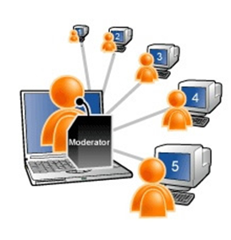











Team work
Team-1
Team-2
Principal Investigator
(1)
Principal Investigator
(1)
Pool of CR/LE
Pool of CR/LE
Paper Coordinator
(16)
CR
Paper Coordinator
(16)
CR
LE
LE
Team of Authors/
Content Writers
Team of Authors/
Content Writers
Team
Notes:
Step by step workflow to execute the Project.

Slide 27
List of Subject Related to Media and Information Literacy under E-PGP
Subject Name | Modules Identified
Library and Information Science | 475
Mass Communication and Journalism | 440
Social work Education | 460
Computer Science | 430
Sociology | 450
Adult Education | 480
Population Studies | 410
Human Rights and Duties | 475
Information Technology | 475

Slide 28
Thanks
Dr Jagdish Arora
Directory, INFLIBNET Centre
director@inflibnet.ac.in

Slide 29
MIL Assessment Framework
UNESCO initiated the development of the MIL Assessment Framework with the aim of providing, its Member States with methodological guidelines and a set of tools to conduct their own assessment of MIL at national, institutional and individual levels.
Structure of the MIL Assessment Framework:
  Tire One: MIL Country Readiness
  Tire Two: MIL Competencies

Slide 30
Tire One: MIL Country Readiness
Media and information in education
Media and information literacy policy
Media and information supply
Media and information access and use
Civil society

Slide 31
Model Curriculum for MIL

